Slide 1
COURSE POSITION 1 OF 14
•
Draft for Review
Operating Systems & Linux Fundamentals
Core OS architecture, Unix heritage, system layers, and safe Ubuntu installation workflows.
2–3 Hours Duration
Ubuntu Desktop LTS Lab

Slide 2
Foundational Protocols
Lesson Goals & Lab Safety
Approved Disks Only
Zero Accidental Erasure
Active Verification
Disposable virtual machine targets.
Verify storage targets before formatting.
Read live system outputs directly.

Slide 3
System Architecture
The Core Role of an Operating System
Resource Arbitrator
Dual Responsibilities
Decides which program uses CPU, memory, and devices.
Hardware Manager & Interpreter
Mediates access to raw silicon while exposing clean, standard interfaces to applications.
Hardware Abstraction
Translates generic write calls into device operations.
Provides convenience, efficiency, and resource protection.
Isolation Boundary
Prevents user applications from damaging host storage.

Slide 4
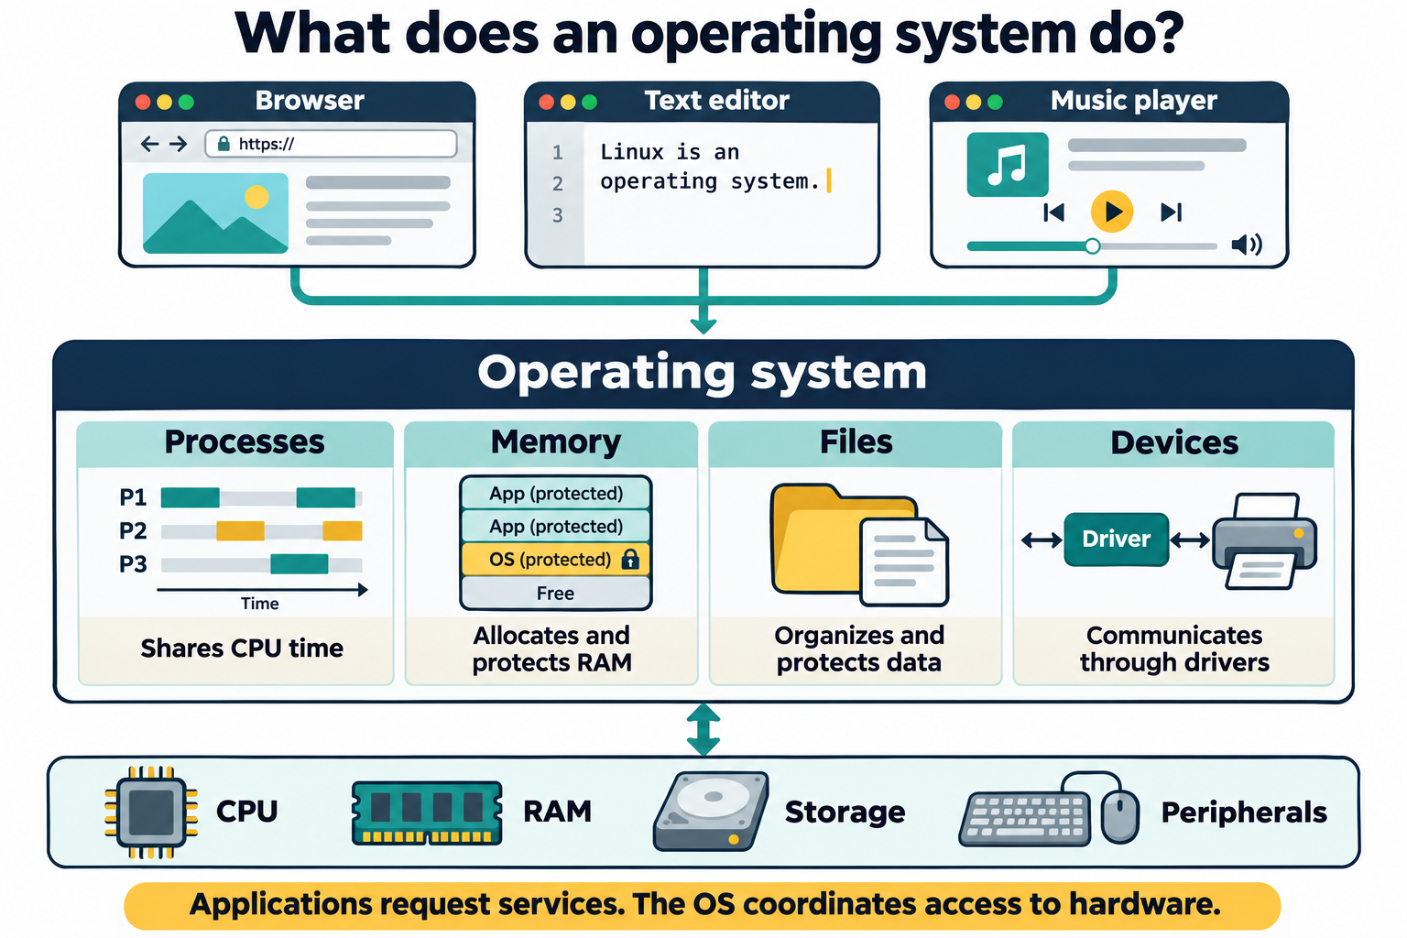

Operating System Roles
Four Core Subsystems
Process Control
Memory Allocation
File Systems
Device I/O
CPU scheduling and states.
Virtual space protection.
Single hierarchical directory tree.
Standardized driver interfaces.

Slide 5
File System Subsystem
Unified Hierarchical Directory Tree
Single Root Namespace
PATH-BASED ABSTRACTION
All physical drives and network volumes attach beneath /.
Hiding Physical Disk Sectors
Applications request reads and writes via structured human-readable paths rather than raw sector offsets.
Protection & Permissions
Prevents user tasks from corrupting host system files.
The file system bridges high-level file naming with durable block storage layouts and metadata structures.
Hardware Independence
Programs run identically across NVMe, SATA, and virtual storage.

Slide 6
User Interfaces
CLI vs. GUI Interfaces
Graphical User Interface
Command-Line Interface
Direct manipulation via visual windows and menus.
Text command entry parsed by an interactive shell.
Ideal Context: Visual media and desktop tasks.
Ideal Context: Remote administration and scripting.
Learning Curve: Discoverable through menu exploration.
Key Strength: High repeatability and low overhead.
Core Examples: GNOME, KDE Plasma, Xfce.
Core Tools: GNU Bash, Zsh, Coreutils.

Slide 7
Historical Lineage
Unix & The GNU Project
1969 • Bell Labs
1983 • Richard Stallman
The Unix Philosophy
The GNU Initiative
Modular design, single-purpose utilities, and plain-text stream connections.
Created a complete free software replacement for Unix user space.
Established the foundational concepts for modern multi-user systems.
Contributed essential compilers, shells, core utilities, and copyleft licenses.

Slide 8
The Missing Piece
Linux Kernel & Open-Source Development
Not Single-Vendor Controlled
Governed through community review, standards, and rigorous release engineering.
1991 • LINUS TORVALDS
A Free Unix-Compatible Kernel
Developed to fill the critical gap in the GNU system, pairing GNU userland utilities with a reliable kernel.
Open Ecosystem Governance
Peer review, automated regression tests, and security response procedures.
Distributed under open-source licensing allowing inspection, modification, and redistribution.
Ecological Flexibility
Permits tailored configurations across supercomputers, clouds, and embedded devices.

Slide 9
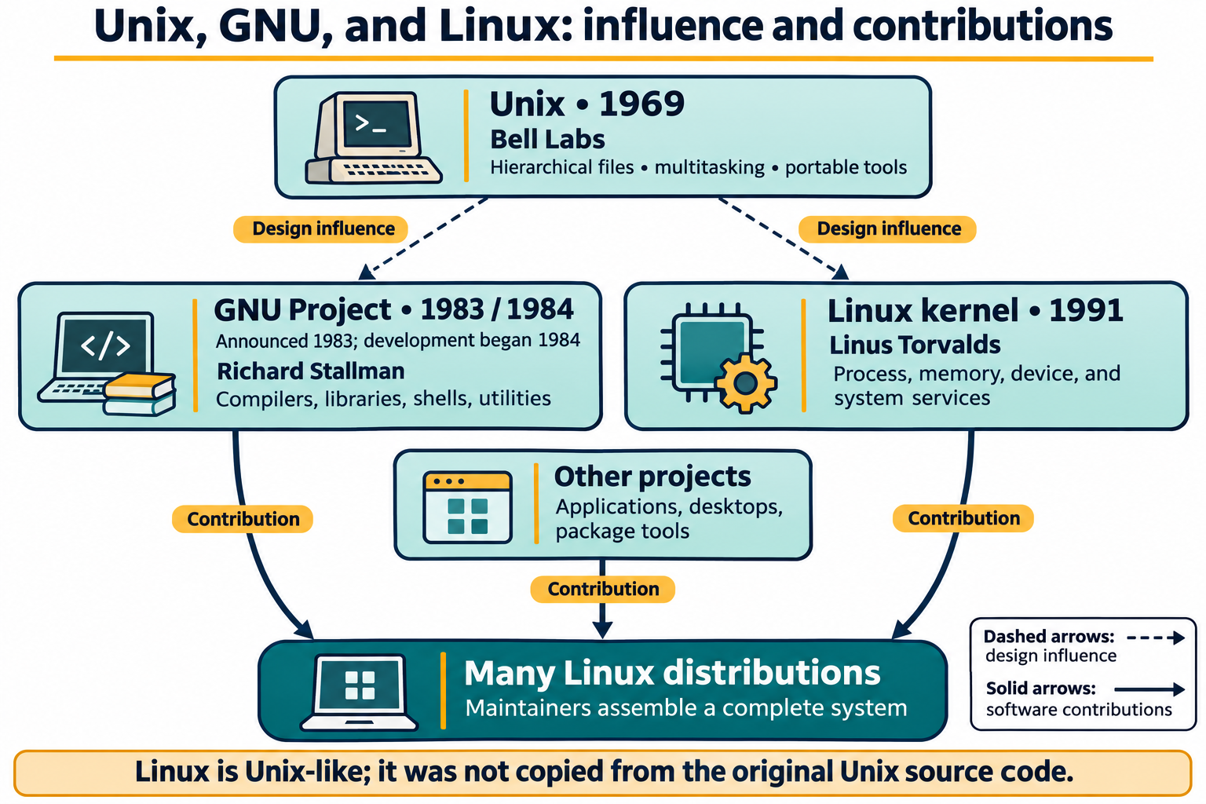

Slide 10
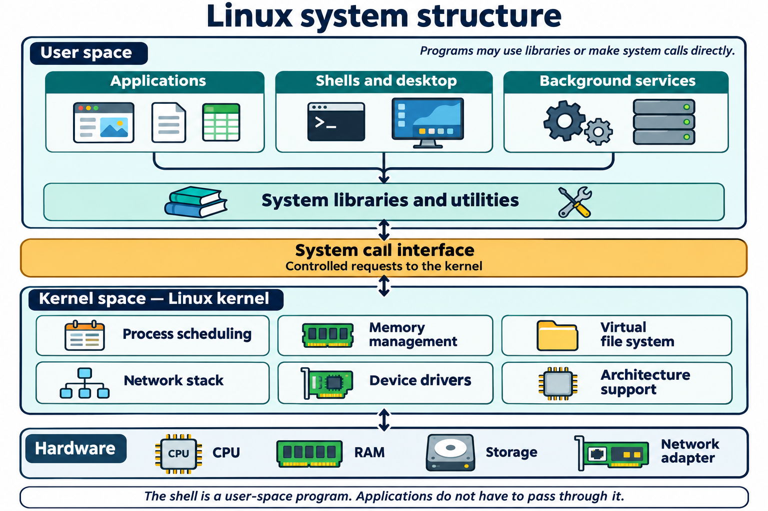
Architecture Stack
The Four Linux System Layers
APPLICATIONS
User Software
Web browsers, editors, database servers, and development environments.
USER SPACE
Shell & Environment
Bash shell, GNU Coreutils, system libraries, and desktop sessions.
Process management, memory paging, device drivers, and system calls.
KERNEL
Linux Kernel
CPU, RAM, storage controllers, network cards, and input peripherals.
HARDWARE
Physical Hardware

Slide 11
Ecosystem Structure
What Defines a Distribution?
The Linux kernel alone is not a complete desktop operating system.
"A distribution bundles the Linux kernel with user space utilities, a package manager, default configurations, and ongoing maintenance."
Package Ecosystem
Support Lifecycles
Target Workloads
Managed software repositories and dependency tracking.
Enterprise LTS branches vs. rolling development tracks.
Tailored for cloud, workstations, or embedded targets.

Slide 12
Evaluation Framework
Key Criteria for Distribution Selection
1. Intended Workload
2. Package Management
3. Release Lifecycle
Desktop graphical productivity vs. headless cloud server.
Tooling, repository catalog size, and dependency resolution.
Long-Term Support (LTS) predictability vs. bleeding-edge rolling updates.
4. Hardware Compatibility
5. Community & Support
Why Ubuntu in Course?
Architecture support (x86_64, ARM, RISC-V) and driver availability.
Documentation quality, vendor SLAs, and active troubleshooting forums.
Broad hardware support, mature LTS lifecycle, and universal transferability.

Slide 13
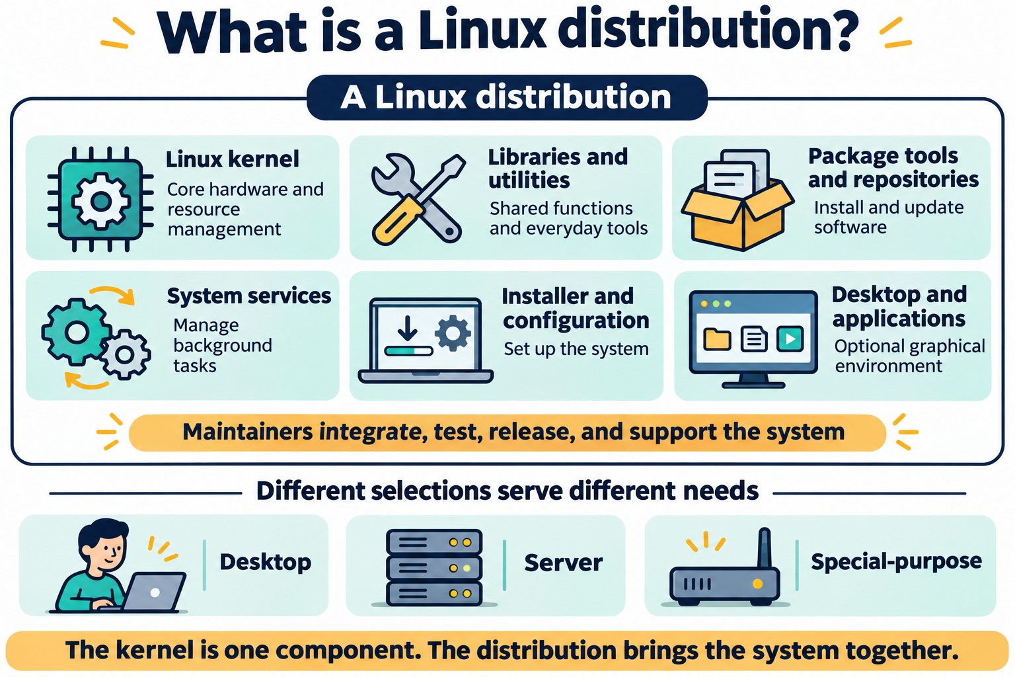

Slide 14
Comparative Analysis
Major Distribution Families
Debian / Ubuntu
Fedora / RHEL
Arch Linux
APT / .deb
DNF / .rpm
Pacman
Extensive ecosystem and predictable LTS support.
Enterprise stability and upstream innovation.
Rolling releases with user-configured minimalism.

Slide 15
Hands-On Practice
Ubuntu Installation Workflow
STEP 01
STEP 02
STEP 03
STEP 04
Boot Media
Select Storage
User Setup
Reboot
Attach verified Ubuntu ISO.
Target virtual disk only.
Create username and credentials.
Disconnect media and sign in.

Slide 16
Live Verification
Post-Installation Inspection
System Identity Commands
Initial Package Refresh
$ whoami # Active user identity
$ sudo apt update
$ hostname # Machine network name
Refreshes repository metadata lists.
$ uname -srm # Kernel and architecture
$ sudo apt upgrade -y
Downloads and applies latest package updates.
$ cat /etc/os-release # Distribution release details

Slide 17
System Observability
Inspecting Hardware & Resources
Processor Overview
Memory Allocation
Storage Topology
$ lscpu
$ free -h
$ lsblk
Displays CPU architecture, core counts, threads, and hardware cache topology.
Summarizes physical RAM and swap capacity, active consumption, and available buffers.
Maps block device hierarchies, partition boundaries, and target mount points.

Slide 18
Lab Reflection
Lab Reflection & Debrief
Critical Installation Hazard
DEMONSTRATION 3 DEBRIEF
Storage selection step: picking the wrong physical drive causes irreversible data loss.
Bridging GUI and CLI Requests
Creating a directory graphically via the desktop file manager versus running mkdir -p ~/lesson1-demo/cli-created in Bash.
Hardware Mediation Layer
The Linux kernel directly manages drivers and raw silicon interactions.
Both interfaces request services from the exact same underlying OS file subsystem.
Kernel vs. Distribution
Ubuntu bundles GNU userland, package management, defaults, and security maintenance.

Slide 19
LESSON 1 REVIEW
Key Concepts & Exit Ticket
"The most important distinction I learned today is the difference between ______ and ______ because ______."
Kernel vs. OS vs. Distro
Storage safety habits
Next: Shell syntax & navigation

